Slide 1
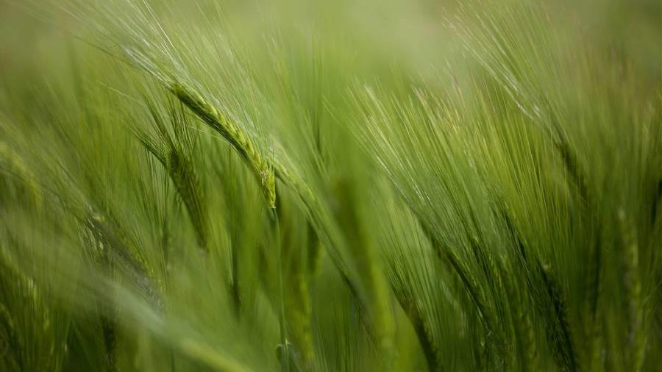
CROP YIELD PREDICTION USING
DEEP NEURAL NETWORK AND
PARTICLE SWARM OPTIMIZATION
GUIDE:
Dr M Sobhana
Sr. Assistant Professor
Pragathi Tummala - 188W1A0542
Sruthi Kakumani - ​188W1A0523

Slide 2
ABSTRACT
Agriculture is the largest livelihood provider in India which plays a vital role in Indian economy to ensure food security. To obtain an effective solution for crop yield prediction Deep learning (DL) could be a major viewpoint. To generate the most yield we consider the factors like temperature, humidity, rainfall, moisture, area. Many researchers have studied on these parameters using machine learning techniques and other statistical methods. This research is mainly based on providing an accurate yield prediction by focusing on the major crops in Andhra Pradesh region. Deep Neural Network (DNN) algorithm is applied on the dataset collected. The results obtained by this method provide major accuracy when compared to other existing methods.
Keywords:
Deep Neural Network (DNN), Crop yield prediction, Temperature, Humidity, Accurate value.

Slide 3
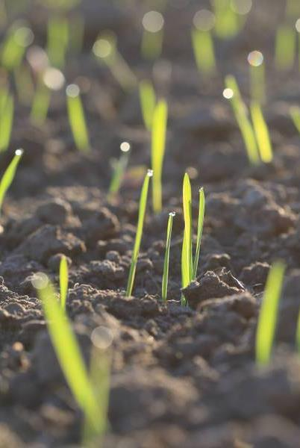
PROJECT TITLE JUSTIFICATION
Crop yield prediction is important for global food production. The difficulty present among farmers is that they don’t opt for proper crop based on the necessities. Due to this productivity is affected. To provide high accuracy and efficiency, Deep Neural Network (DNN) algorithm is applied on the crop data.

Slide 4

Objective
To deliver direct advisory services to even the smallest farmer at the level of his/her smallest plot of crop, using the most accessible technologies.
To increase the throughput of the agriculture sector with the Deep Learning models and optimization techniques.

Slide 5
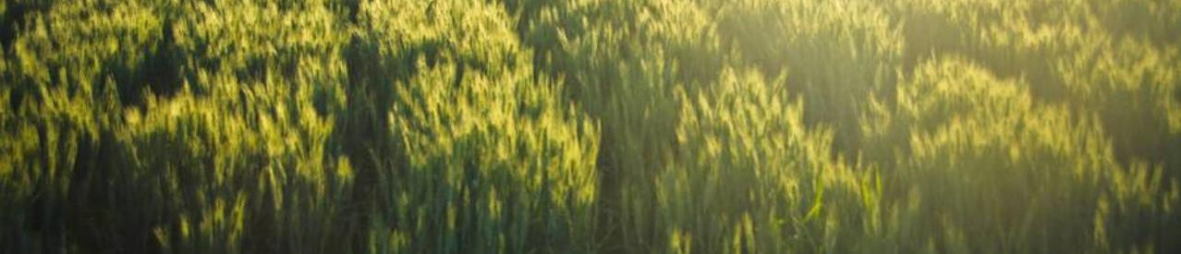
This method is characterized by a crop production data and climatic data collected from the farm.
The data is stored, analyzed and preprocessed for forecasting the crop yield.
The data includes factors like temperature, rainfall, area, soil moisture, humidity etc.
The scope of our project is to predict the crop yield mainly in Andhra region which would help farmers pick most suitable crops.
Scope

Slide 6
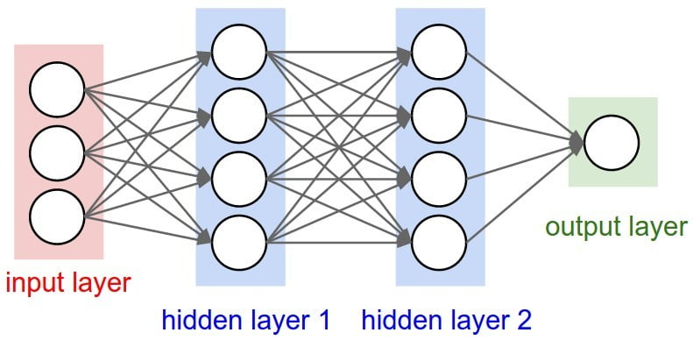
Basic concepts
Deep Neural Networks (DNN)
A deep neural network (DNN) is an artificial neural network (ANN) with multiple layers between the input and output layers. At its simplest, a neural network with some level of complexity, usually at least two layers, qualifies as a deep neural network (DNN), or deep net for short.
At first, the DNN creates a map of virtual neurons and assigns random numerical values, or "weights", to connections between them.

Slide 7
CROP YIELD
In agriculture, the yield is a measurement of the amount of a crop grown, or product such as wool, meat or milk produced, per unit area of land. The seed ratio is another way of calculating yields.
Innovations, such as the use of fertilizer, the creation of better farming tools, new methods of farming and improved crop varieties, have improved yields.
The higher the yield and more intensive use of the farmland, the higher the productivity and profitability of a farm; this increases the well-being of farming families. Surplus crops beyond the needs of subsistence agriculture can be sold or bartered.
The more grain or fodder a farmer can produce, the more draft animals such as horses and oxen could be supported and harnessed for labor and production of manure. Increased crop yields also means fewer hands are needed on farm, freeing them for industry and commerce.

Slide 8
literature survey
Crop Yield Prediction Using Deep Neural Networks [1]
Published In: Frontiers in Plant Science
Methodology:
In this paper, the genotype data coded in {−1, 0, 1} values were preprocessed before using the neural network model. To impute the missing data in the remaining part of the genotype data they found that median approach led to the most accurate predictions.
Neural networks was used for weather prediction, to capture the nonlinearities, which exist in the nature of weather data.
Two deep neural networks were trained, one for yield and the other for check yield, and then used the difference of their outputs as the prediction for yield difference.
Dataset: 2,267 experimental hybrids planted in 2,247 of locations between 2008 and 2016 across the United States and Canada.
Advantages:
Superior prediction accuracy, with a root-mean-square-error (RMSE).
Decreased the dimension of the input space without significant drop in the prediction accuracy.
Disadvantages:
A major limitation is black box property.
Complex model structure makes it hard to produce testable hypotheses that could potentially provide biological insights.

Slide 9
Artificial Neural Network to Estimate the Paddy Yield Prediction Using Climatic Data [2]
Published In: Mathematical Problems in Engineering
Methodology:
In this paper, MATLAB numerical computing environment was used to develop the ANN architectures to predict the paddy yield.
One hidden layer was included in the ANN architecture with the dependent variable of the paddy yield. One hidden layer was included in the ANN architecture with the dependent variable of the paddy yield.
The climatic parameters were included as the input parameters. The training step was started with selection of the training algorithms, Levenberg–Marquardt, Bayesian Regularization, and Scaled Conjugate Gradient. Lowering the MSE values and bringing near the R values to 1 give better predictions.
Dataset: http://www.data.gov.lk/dataset/paddy-production-yala-season-1952-2012
http://www.data.gov.lk/dataset/paddy-production-maha-season-1952-2012
Advantages:
Nonlinear complex relationships among various climatic factors and paddy yield were obtained.
LM algorithm can be used in future predictions at lower computational costs.
Disadvantages:
The models have to be further improved using more climatic parameters.

Slide 10
Review on Crop Prediction Using Deep Learning Techniques [3]
Published In: Journal of Physics: Conference Series
Methodology:
The study on the crop yield prediction has been made by different deep learning techniques such as ANN, CNN, DNN, RNN, hybrid network.
ANN was trained with the data of environmental factors and crop images for the crops such as wheat, barley, sugar beet, potato and sunflower.
In DNN, In this process plant genotype and other plant growing properties are mapped with the climate to predict the crop yield. The crop of maize and rice were taken and its genotype were mapped and trained with the DNN.
In LSTM, The crops were monitored based on the vegetative index, whether and climatic data along with all environmental factors where mapped.
Advantages:
All the above techniques has the accuracy above 85% .
RNN and hybrid network outperforms the other entire network and achieves the accuracy of maximum 90%.
Disadvantages:
Combining RNN with hybrid network can also provide a new inference to artificial intelligence in agriculture.

Slide 11
Prediction of Rice Yield in East China Based on Climate and Agronomic Traits Data Using Artificial Neural Networks and Partial Least Squares Regression [4]
Published In: Agronomy Journal
Methodology:
In this paper, rice yields were predicted using a variety of algorithms, including the non-linear tool of feed-forward backpropagation neural networks (FFBN) and the linear model of partial least squares regression (PLSR).
The PLSR model showed that covariates occurred among the parameters, and modifications should be considered for climate data-based modelling.
In FFBN, To obtain a best neural network chose a network structure with similar prediction accuracy between the training and testing sets as the optimal architecture.
Dataset: http://data.sheshiyuanyi.com
Advantages:
The FFBN model showed better prediction performance using the optimum neural network architecture of one hidden layer with 29 neurons.
Disadvantages:
Although climate data could be used for rice prediction, proper modifications should be made to improve the reliability and accuracy of the modelling.

Slide 12
Crop Yield Prediction using Machine Learning [5]
Published In: International Journal of Science and Research
Methodology:
In this paper, machine learning algorithms were used to predict the yield of crop before cultivating onto the agricultural field.
Random forest algorithm is used by analyzing all issues of weather, temperature, humidity, rainfall, moisture etc.
It operates by constructing a multitude of decision trees during training tree & generating the output of the class that is the mode of the classes or mean prediction of the individual trees.
Advantages:
The developed webpage is user friendly and the accuracy of the predictions are above 75% in all the crops.
Disadvantages:
Random forest creates a lot of trees and combines their outputs so the complexity is high.
It require much more time to train as compared to decision trees as it generates a lot of trees and make a decision on majority of votes

Slide 13
Deep Learning with Particle Swarm Based Hyper Parameter Tuning Based Crop Recommendation for Better Crop Yield for Precision Agriculture [6]
Published In: Indian Journal of Science and Technology
Methodology:
Deep learning method is adopted in this work. Historical data on crop productions and climate data is used in this work.
The data is then pre-processed followed by predictions using a Modified DNN (Deep Neural Networks) and PSO (Particle Swarm Optimization) called PSO-MDNN for recommending crop cultivation.
This work proposed MDNN where the weight matrices are calculated with L2 regularization and PSO utilized to tune the hyper parameters of MDNN and its network structure.
In this paper, different algorithms like Decision-Tree, KNN, Random-Forest, are compared.
Advantages:
It could be used in future yield predictions of crops with accuracy value of 95.49%.
The accuracy is more compared to other techniques in its benchmarks such as Dec-Tree, KNN, R-forest, Neu-Net.
Disadvantages:
It could be extended with a hybrid model as either low-yielding or high-yielding based on its relative performance against other hybrids at the same application of producing crop recommendation.

Slide 14
Predicting Yield of the Crop Using Machine Learning Algorithm [7]
Published In: International Journal of Engineering Sciences & Research Technology
Methodology:
This paper uses R programming with Machine Learning techniques. R is the leading tool for statistics, data analysis, and machine learning.
This was sourced for the years 1997 to 2013 for different seasons like Kharif and Rabi of rice production. From the vast initial dataset Split the loaded data sets into two sets such as training data and test data in the split ratio of 67% and 33%.
Then calculate Mean and Standard Deviation for needed tuples and then summarize the data sets. Compare the summarized data list and the original data sets & calculate the probability.
Based on the result the largest probability produced is taken for prediction. The accuracy can be predicted by comparing the resultant class value with the test data set. The accuracy can range from 0% to 100%.
Advantages:
The Random Forest algorithm achieves a largest number of crop yield models with the lowest models.
It is suitable for massive crop yield prediction in agricultural planning.
Disadvantages:
The dataset includes very few attributes that would not give accurate predictions.

Slide 15
Heuristic Prediction of Crop Yield using Machine Learning Technique [8]
Published In: International Journal of Engineering and Advanced Technology
Methodology:
In this paper, the data sets of different districts of the Telangana state are collected from Telangana State Development Planning Society. The important factors that determine the crop yield are temperature, humidity, soil moisture and rainfall.
Among the data set available maximum of the data was used for training and the remaining data was used for testing. The machine learning technique KNN algorithm was used for prediction of crop yield.
With respect to the application of KNN algorithm towards prediction of crop yield, the nearest neighbors of a particular point (crop yield) like temperature, humidity, rain fall and soil moisture were considered.
Advantages:
KNN as the most appropriate one with maximum accuracy.
Disadvantages:
Does not include recommendation of fertilizers or crops based on the soil, climate and location.

Slide 16
DATA COLLECTION
The dataset consists of different features like crop_year, season, crop, area and production.
Climatic factors like temperature, humidity are also taken into consideration to predict the yield of the crop.
The scope of this project is to find the crop yield prediction mainly in Andhra Pradesh region.
Dataset links:
https://data.world/thatzprem/agriculture-india
https://aps.dac.gov.in/APY/Public_Report1.aspx

Slide 17
Methodology
The data is then pre-processed which are then trained by DNN and optimized by PSO. It is followed by predictions using a DNN (Deep Neural Networks)
DNN sub-models for each group of datasets i.e. the choice of DNN’s hidden layers, neuron count in the hidden layers, activation function and training approaches of the predictive model.
DNNs use multiple layers in succession where the output of one layer becomes the input of the next layer. The count of the layers used is the depth of a DNN. DNNs also use fuzzy logic in certain layers called hidden layers.
DNNs are very popular as they select features that are most suitable before classifying them. The proposed DNN classifies pre-processed data into suitable and non-suitable crops.
The decision regarding every INPUT node is taken by DNN and then sent to the next tier which are then trained. Pre-processed input data D is trained by DNN using input, hidden and output layers.

Slide 18
The network uses many hidden layers between inputs and outputs. Input layer elements or data points are assigned weights and then processed by subsequent layers.
DNN assigns weights in each layer while processing till the final output is obtained.
This learning cycle is cycle is repeated until DNN assesses the relationship between inputs and extracted data thus resulting in a set of learned classes based on which prediction can be done.

Slide 19
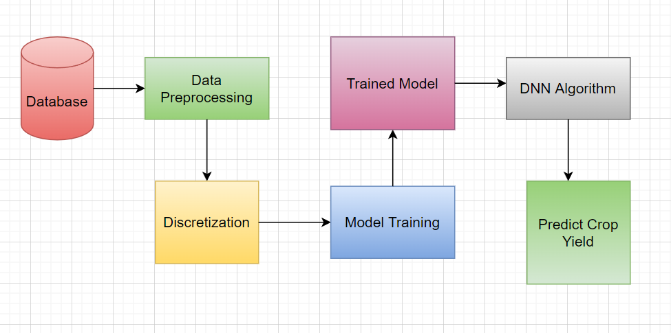
Methodology

Slide 20
references
Saeed Khaki, Lizhi Wang, “Crop Yield Prediction Using Deep Neural Networks”, in Frontiers in Plant Science, 22 May 2019.
Vinushi Amaratunga, Lasini Wickramasinghe, Anushka Perera, Jeevani Jayasinghe, Upaka Rathnayake, “Artificial Neural Network to Estimate the Paddy Yield Prediction Using Climatic Data”, Mathematical Problems in Engineering Volume 2020.
M. K Dharani, R Thamilselvan, P Natesan, PCD Kalaivaani, Santhoshkumar, “Review on Crop Prediction Using Deep Learning Techniques”, Journal of Physics: Conference Series 2021.
Yuming Guo, Haitao Xiang, Zhenwang Li, Fei Ma, Changwen Du, “Prediction of Rice Yield in East China Based on Climate and Agronomic Traits Data Using Artificial Neural Networks and Partial Least Squares Regression”, Agronomy 2021.
Mayank Champaneri, Chaitanya Chandvidkar, Darpan Chachpara, Mansing Rathod, “Crop Yield Prediction Using Machine Learning”, International Journal of Science and Research, April 2020.

Slide 21
references
6) K Mythili, R Rangaraj, “Deep Learning with Particle Swarm Based Hyper Parameter Tuning Based Crop Recommendation for Better Crop Yield for Precision Agriculture”, Indian Journal of Science and Technology, Volume 14, Issue-17, 2021.
7) P. Priya, U. Muthaiah & M. Balamurugan, “Predicting Yield of the Crop Using Machine Learning Algorithm”, International Journal of Engineering Sciences & Research Technology (IJESRT), April 2018.
8) S. Pavani, Augusta Sophy Beulet P., “Heuristic Prediction of Crop Yield using Machine Learning Technique”, International Journal of Engineering and Advanced Technology (IJEAT) Volume 9, December 2019.

Slide 22
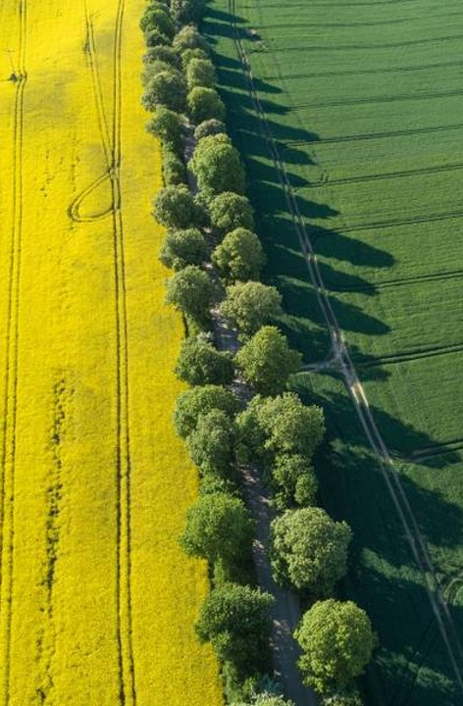
TIME PLAN of project
TASK | DATE
Project Title | 07/10/21
Abstract | 16/10/21
Objective and Scope | 21/10/21
Report on Abstract, Introduction and Literature Survey | 06/11/21
Analysis of identified problem, Data collection, Methodology | 09/11/21
Report on design, Algorithm, Coding | 27/11/21
Implementation and Testing | 30/11/21
Rough Draft | 06/12/21
Final Dissertation | 16/12/21

Slide 23
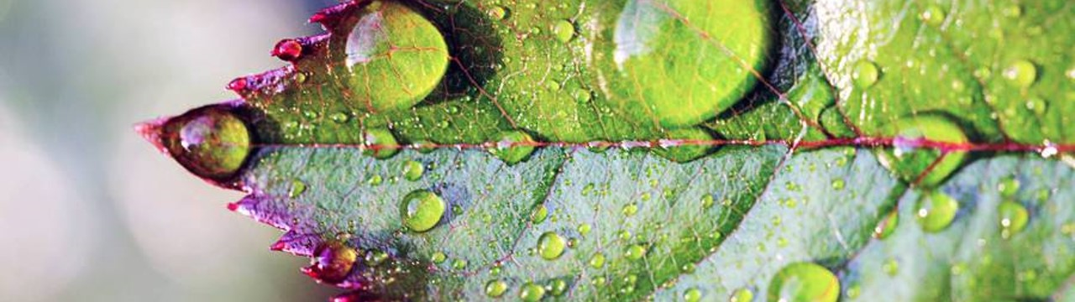
THANK YOU

